Slide 1
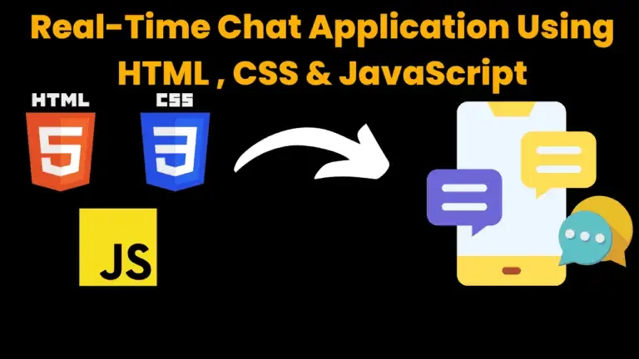

Slide 2

🔍 Objective
The main objective of this project is to design and develop a simple yet functional web-based chat application using front-end technologies (HTML, CSS and JavaScript). This application allows users to send and receive messages in a conversational interface, simulating a basic chat experience.

Slide 3
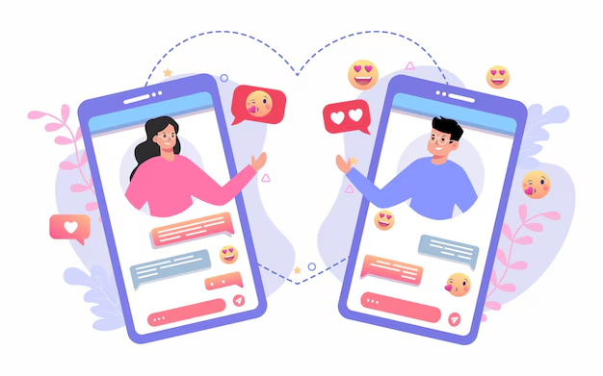
WHAT IS CHAT
Real-time communication between
two users via computer. Once a chat has been initiated, either user can enter text by typing on the keyboard and the entered text will appear on the other user's monitor.

Slide 4

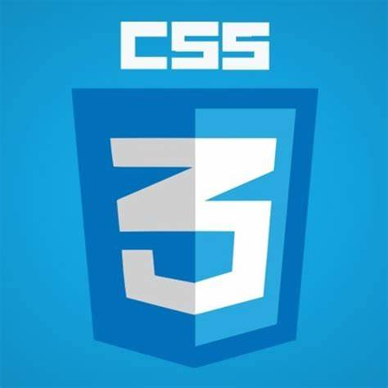
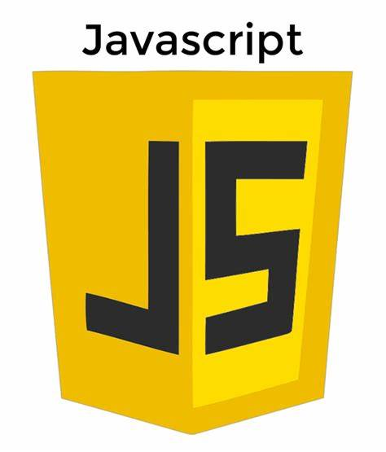
⚙️ Technologies Used
HTML – To structure the chat application.
CSS – To style the application and make it visually appealing and responsive.
JavaScript – To add interactivity and handle chat logic, message rendering, timestamps, and data storage using localStorage.

Slide 5
🧩 Features Implemented
User Interface:
Clean, responsive layout using CSS Flexbox and media queries.
Chat bubble design for user and bot messages.
Scrollable chat window.
2. Messaging System:
Input field for typing messages.
Button to send messages.
Auto-reply bot messages.
3. Timestamps:
Each message includes the time it was sent.
4. Data Persistence:
Chat history is saved using localStorage, so it remains available after page reloads.
5. Message Rendering:
Dynamic DOM manipulation to display sent and received messages in the chat window.

Slide 6
🧠 Working Principle
The user types a message in the input box and clicks send.
JavaScript captures the input, adds the message to the chat window, and stores it in localStorage.
A simulated bot reply is generated after a short delay.
Both user and bot messages are displayed with timestamps.
On page load, stored messages are retrieved and rendered from localStorage.

Slide 7
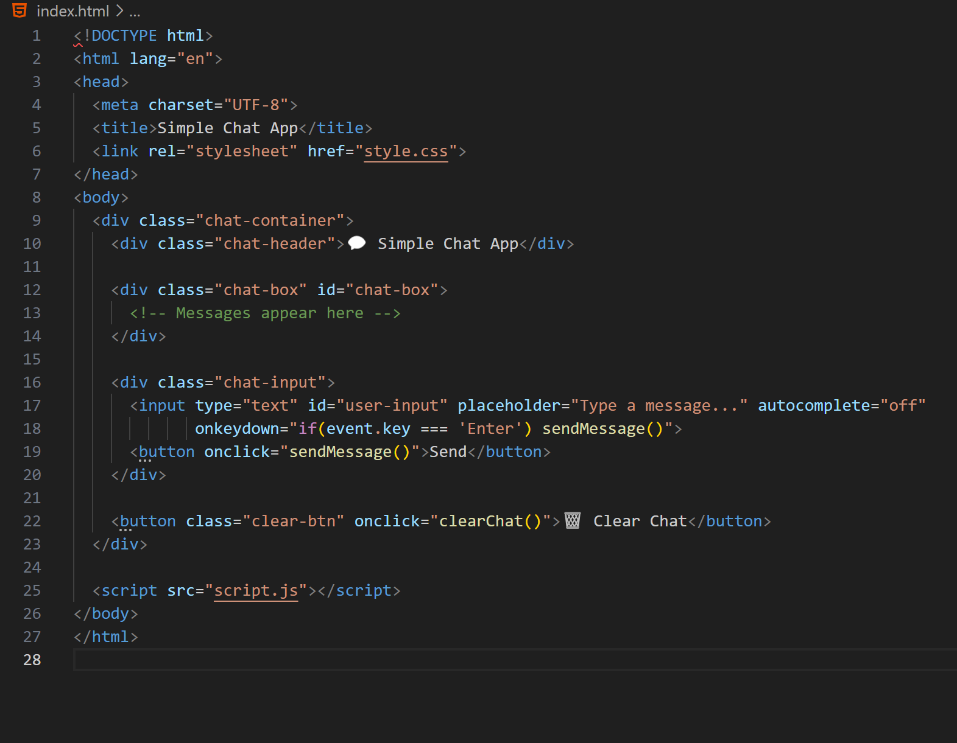
HTML

Slide 8
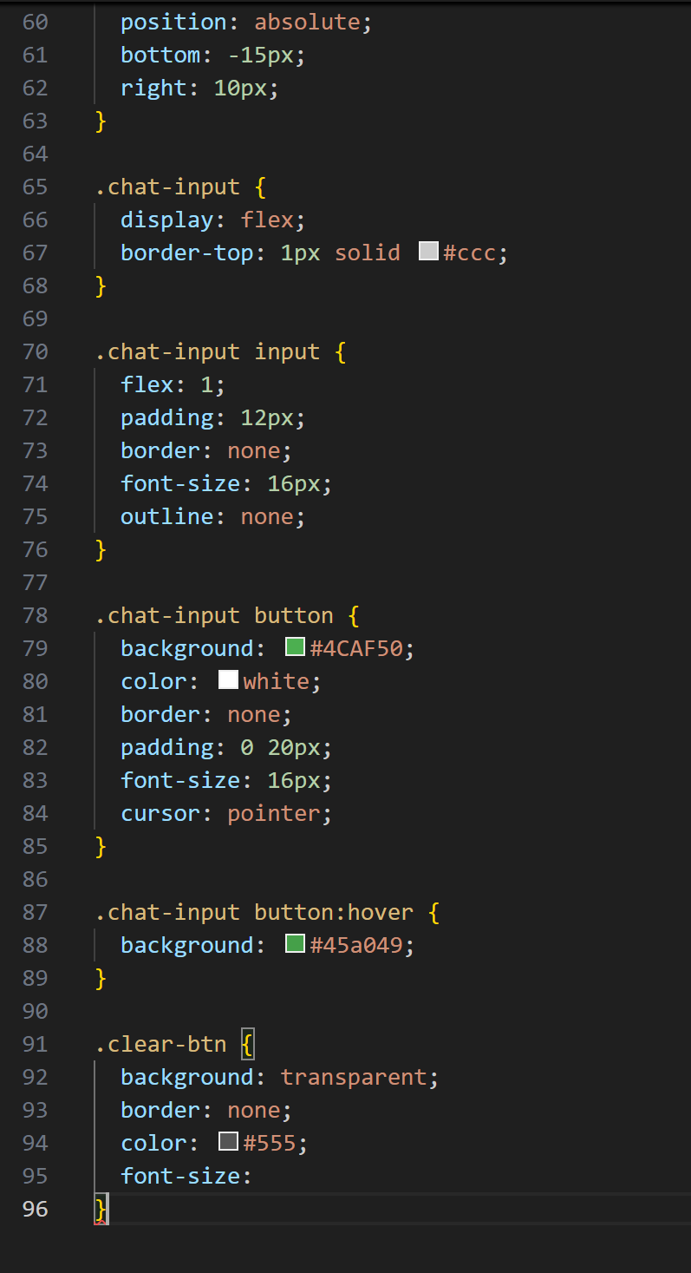
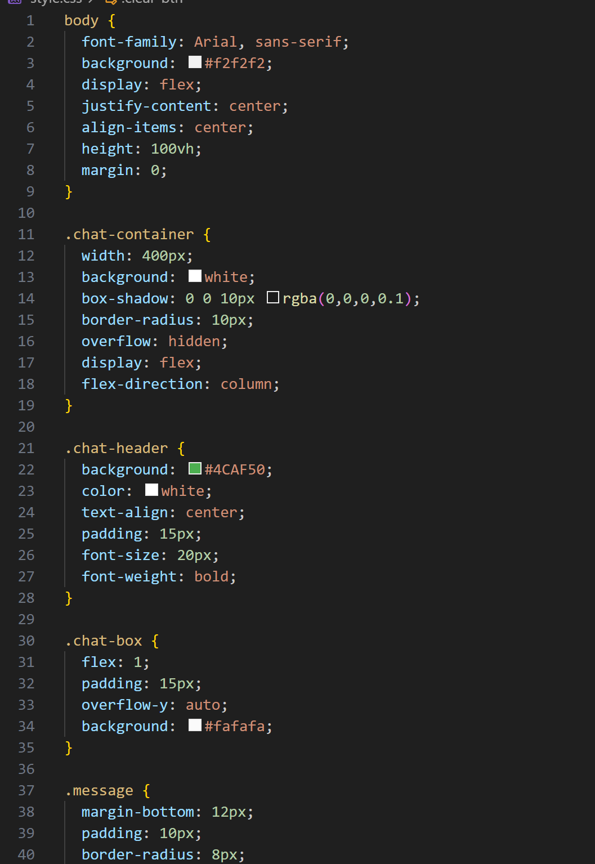
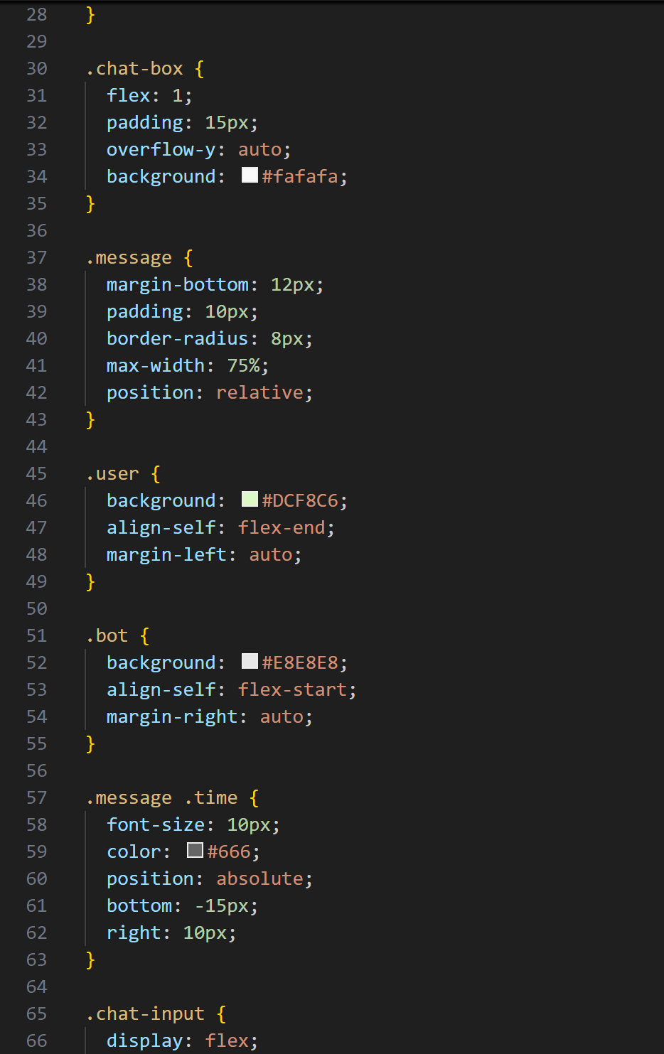
CSS

Slide 9
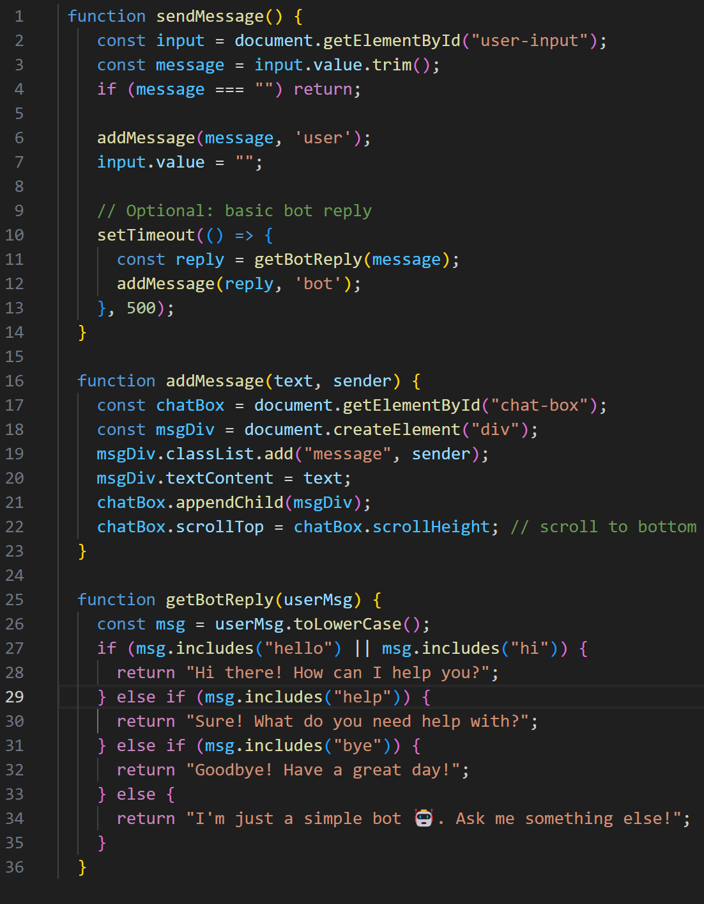
JavaScript

Slide 10
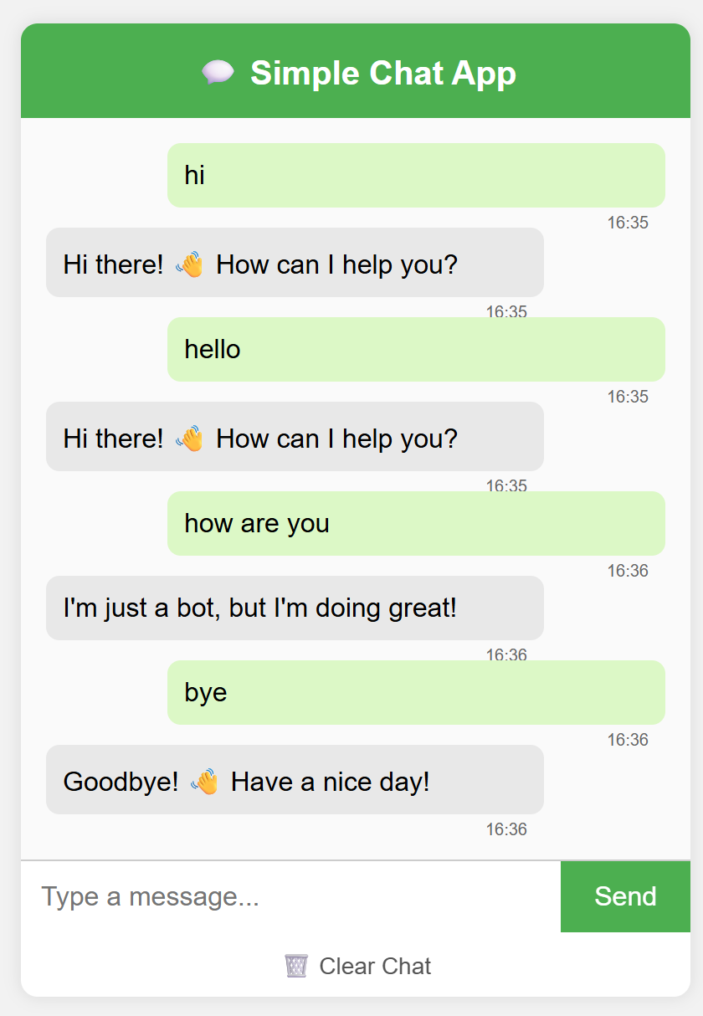
output

Slide 11
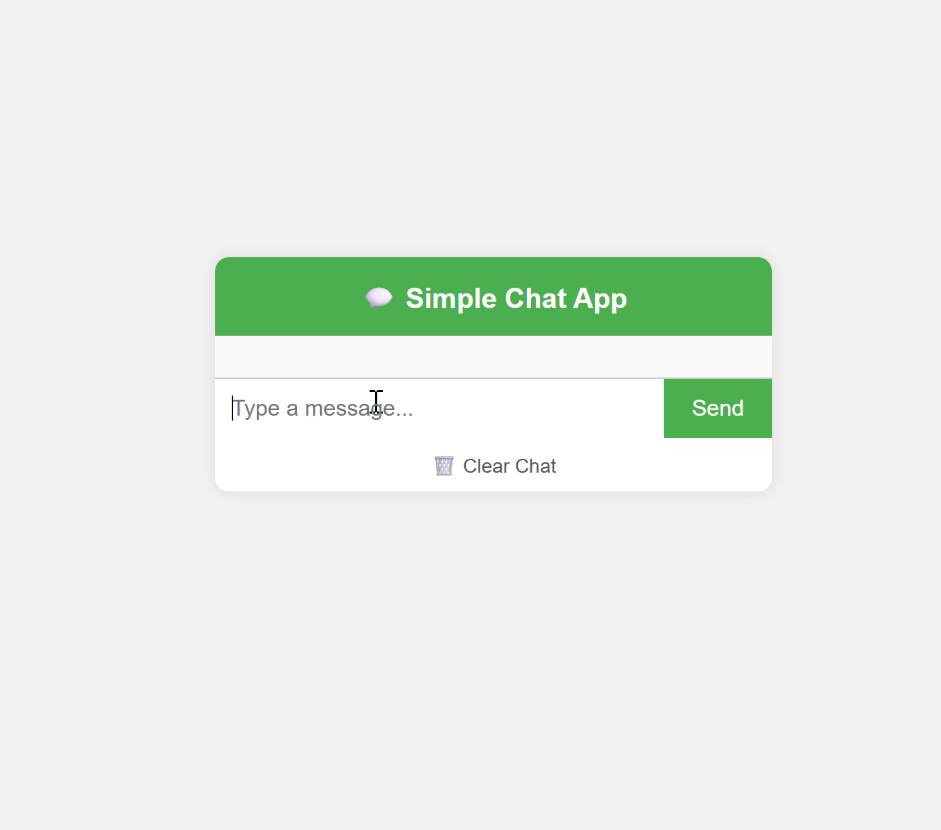
demo

Slide 12
Social media link
Netlify Link: Simple Chat App
GitHub Link:

Slide 13

📈 Future Enhancements
👨‍💻 C Conclusion
This project demonstrates the ability to build a fully functional client-side chat interface using only HTML, CSS, and JavaScript. It reinforces concepts like DOM manipulation, event handling, data storage with localStorage, and user experience design.
Add user authentication.
Implement real-time messaging using WebSockets (e.g., with Node.js & Socket.IO).
Enable group chat or multi-user support.
Add emojis, media sharing, or message editing/deleting.
Add dark/light theme toggle

Slide 14
Thank you
Brita Tamm
502-555-0152
brita@firstupconsultants.com
www.firstupconsultants.com

